Slide 1
Predicting COE
Joel Tan, Goh Peng Aik, Khant Nyi Nyi
Notes:
Good afternoon everyone. My name is Joel and these are my groupmates Khant and Peng Aik. Our mini project is on predicting COE prices.

Slide 2
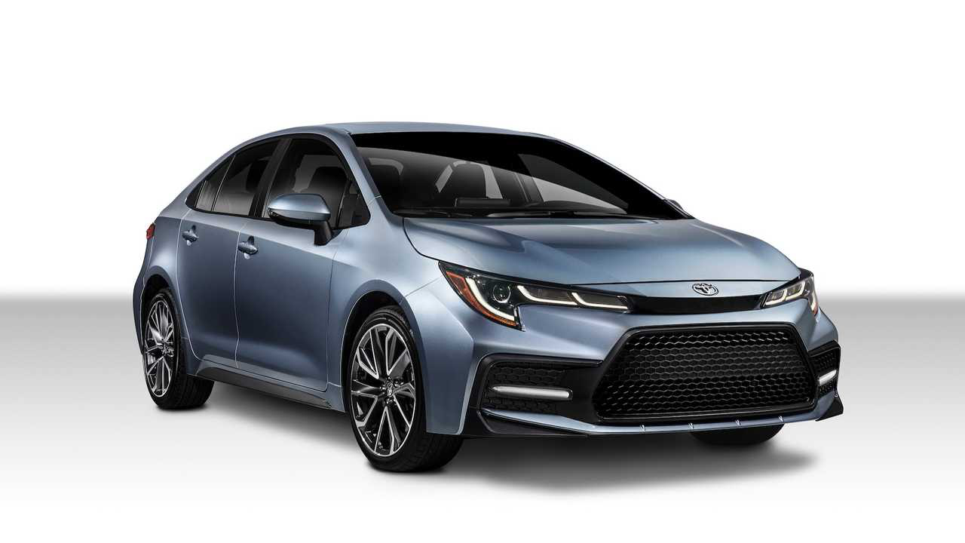
Notes:
Who here would like to buy a car in the future?
Anybody knows what car this is?
Make a guess on how much this Toyota corolla cost in SG

Slide 3
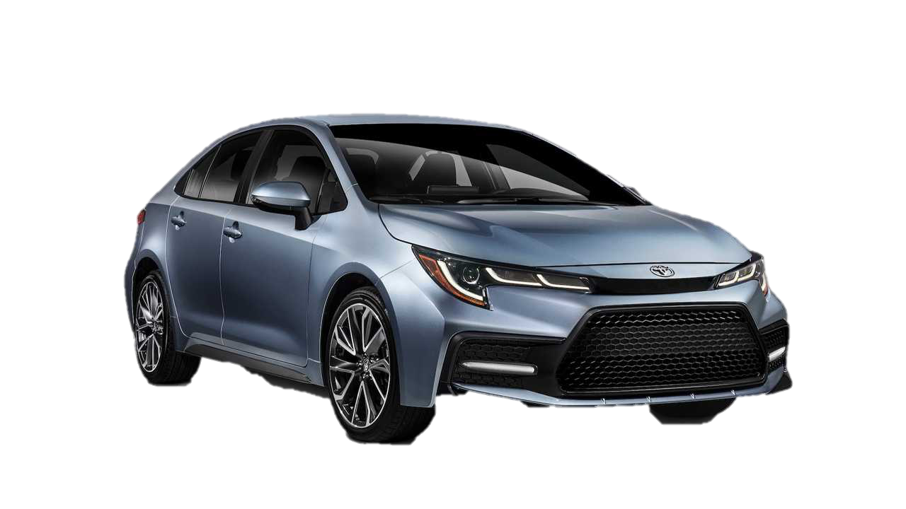
Car Prices in SG
Final Base Price
$81,734
Initial Selling Price
$19,741
Notes:
The initial selling price of just the car alone is $19,741 but when you include all the additional expenses you need to incur when you own the car , it becomes $81,734. That is 4x (400%) more than what its initially sold for.

Slide 4
Cost Breakdown of Cars
Notes:
So what are you actually paying for to own a car? Let’s take a look at the cost breakdown that led to you paying over $80,000 for a car. Open Market Value (OMV) is the actual selling price of the car while the exercise duty, additional registration fee, GST and COE are taxes imposed on buying a car. You can see that the Certificate of Entitlement (COE) costs about $36,000 and takes up 45% of the total cost of a car

Slide 5

How does COE work?
Notes:
And since our project is on predicting COE prices, I’d like to first share with you guys on how COE works to provide everyone with some context to our project, so that the data seems more meaningful.

Slide 6

How does COE work?
VS
Self Bid
Dealer Bid
Notes:
To get a COE, car buyers can either bid for it themselves or rely on a car dealer to bid it for them. Most people would rather choose to take up a dealer bid package to avoid the hassle of bidding for the COE on their own as they are not familiar with the bidding prices or the procedures to place the bid.
However, the car dealers will only make a bid for your COE after you purchase your car and they’ll quote you higher prices for the COE to ensure you don’t fail the bid even if the price rises above expectations.

Slide 7





How to bid for COE?
Open Bidding System
$30,000
$28,000
$32,000
$45,000
$25,000
Notes:
Now, this is how the bidding process works. Imagine that there is a quota of 3 COEs to be issued but there are 5 people bidding. Each person there makes their respective bid of $30,000 , $28,000 and so on. The bid works on an open bidding system so the current bids placed are available and accessible to the public. Once the bidding closes, the top 3 highest bidders will get the COE and they will pay the premium of the highest unsuccessful bid plus $1.

Slide 8
How to bid for COE?
Open Bidding System
COE Premium Bid will be $28,001
$30,000
$28,000
$32,000
$45,000
$25,000
Notes:
This means that the bid premium for this exercise is $28,001.

Slide 9



Why are we predicting COE Prices?
Greater convenience for potential car buyers
Cost-savings for car buyers
Commissionable Service
Notes:
We chose to predict COE prices so that we can bring about greater convenience for car buyers to gauge the fluctuating COE prices and also allow them a chance at saving costs when they self-bid. Through these two gaps, we believe that we can make this a commissionable service where we

Slide 10
Business Case
Commissionable Service
We’ll take a 5% commission fee of the COE premium when users bid with our predictions
Notes:
Will take a 5% commission fee of the COE premium when users bid with our predictions. This will be our business model for our data science project.
Now I’ll hand over the time to Peng Aik where he will share on how we predicted the COE prices.

Slide 11
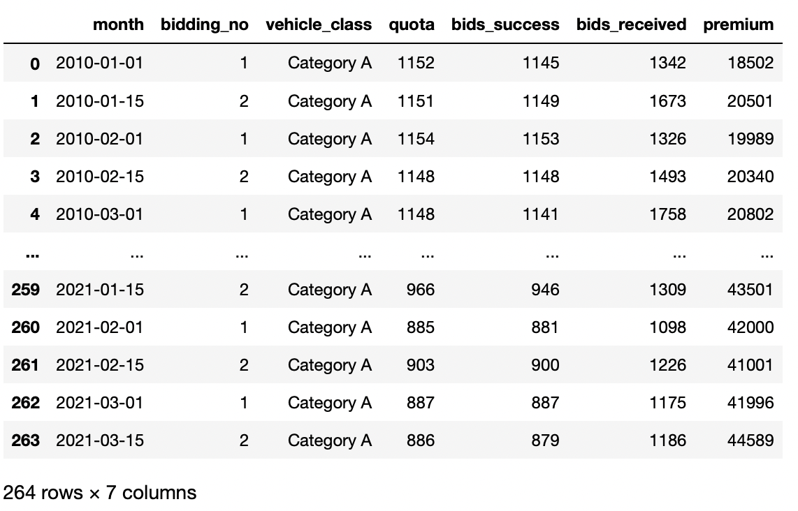
How do we predict COE Prices?
Notes:
Transform excel spreadsheet with months to premium price over time.
Talk about the 2 bidding exercises in a month. 24 bidding exercises in a year.

Slide 12
Steps to Do!
Visualise the Data
Build the ARIMA Model
Make Predictions
Stationarize the Series
Find Optimal Parameters

Slide 13
Steps to Do!
Visualise the Data
Build the ARIMA Model
Make Predictions
Stationarize the Series
Find Optimal Parameters

Slide 14
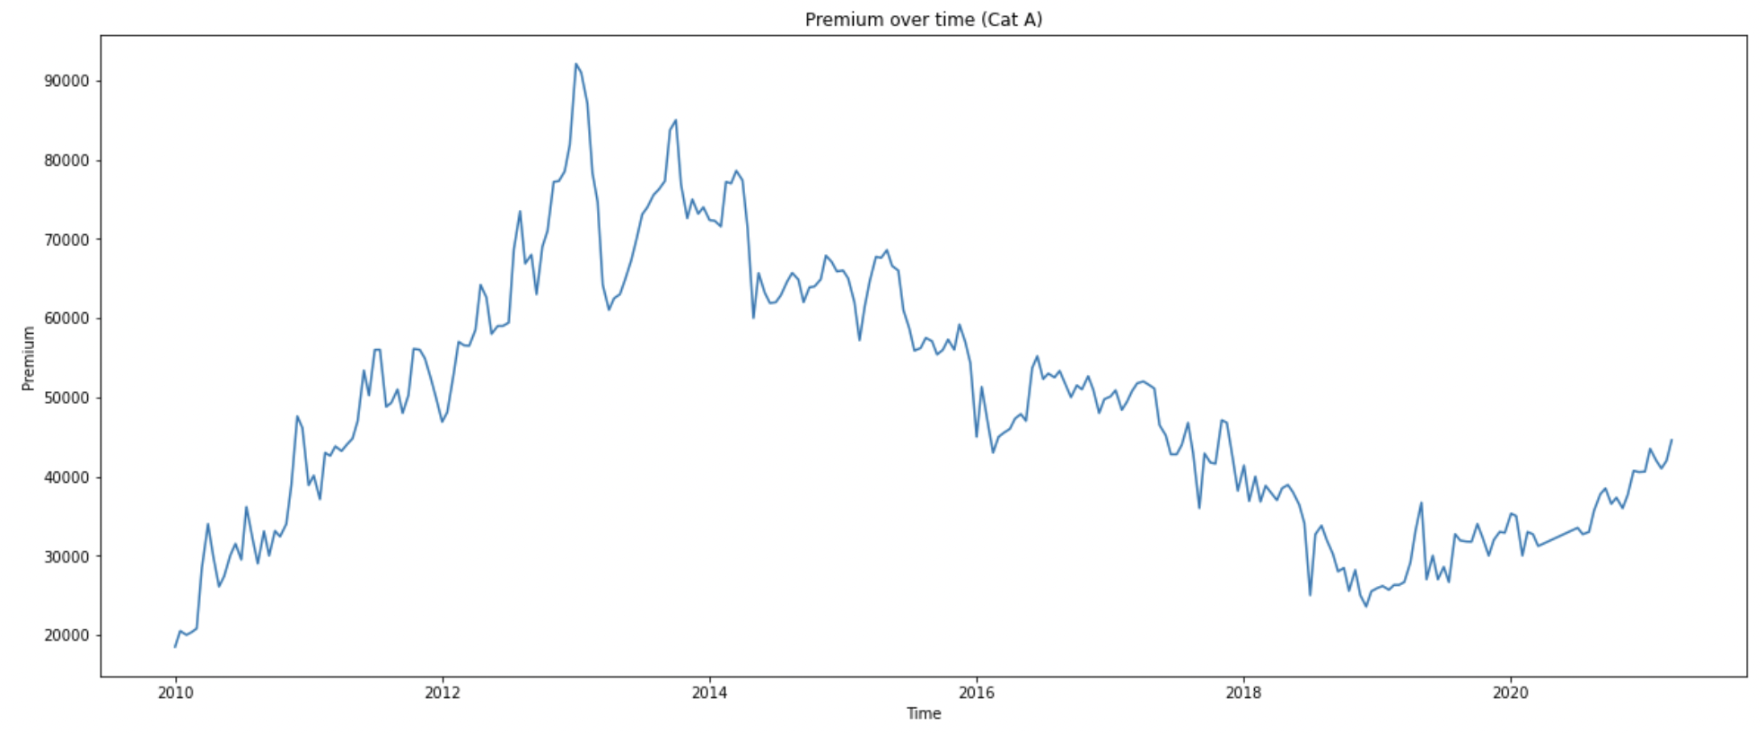
Exploratory Data Analysis
Notes:
Include point on why there are certain spikes
Why did we choose 2018 December to start analysis?
Drastic Drop in prices in 2013: The government curbed car loans drastically and introduced a tiered tax system for luxury cars to control the spike in COE prices ( (https://www.straitstimes.com/singapore/inflation-may-not-fall-even-if-coe-tumbles)
Change in Vehicle growth from 2017: In 2017, the government announced that the vehicle growth will be reduced to 0% for private cars and motorcycles (Cat A, B and D) and this will continue till 2022. This means: number of vehicles registered (quota) = number of vehicles deregistered. (https://www.channelnewsasia.com/news/singapore/lta-singapore-vehicle-growth-rate-zero-cars-motorcycles-13018098#:~:text=The%20growth%20rate%20for%20goods,the%20number%20of%20vehicle%20deregistrations.)

Slide 15
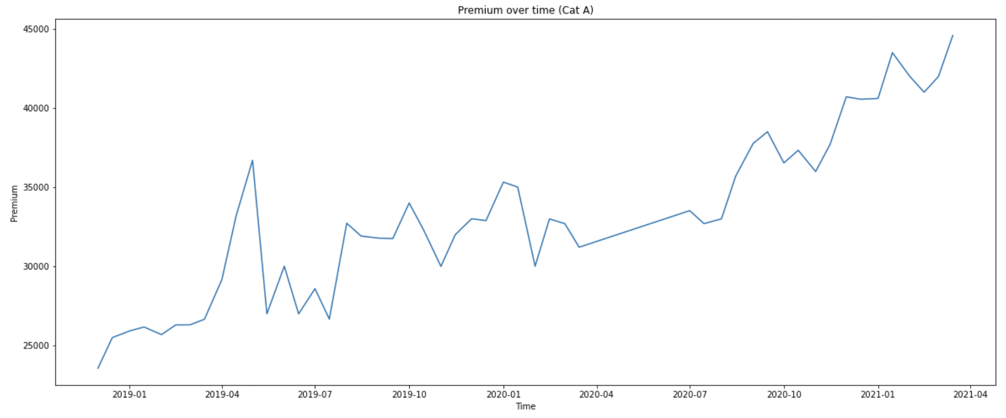
Exploratory Data Analysis

Slide 16
Forecasting Model
A R I M A
Auto Regressive
(p)
Integrated
(d)
Moving Average
(q)
Notes:
To predict the future premium, we used ARIMA as the forecasting model. ARIMA stands for Auto Regressive Integrated Moving Average and it has 3 components to the model. The autoregressive order, the degree of differencing and the moving average order or p,d and q in short (click)

Slide 17
Steps to Do!
Visualise the Data
Build the ARIMA Model
Make Predictions
Stationarize the Series
Find Optimal Parameters
Notes:
Before we can use an ARIMA model, we need to make sure that the time series is stationary. A stationary time series is a time series whose properties do not depend on the time at which the series is observed, which basically means it has no trend or seasonality. We use the Augmented Dickey Fuller Test to test for stationarity

Slide 18
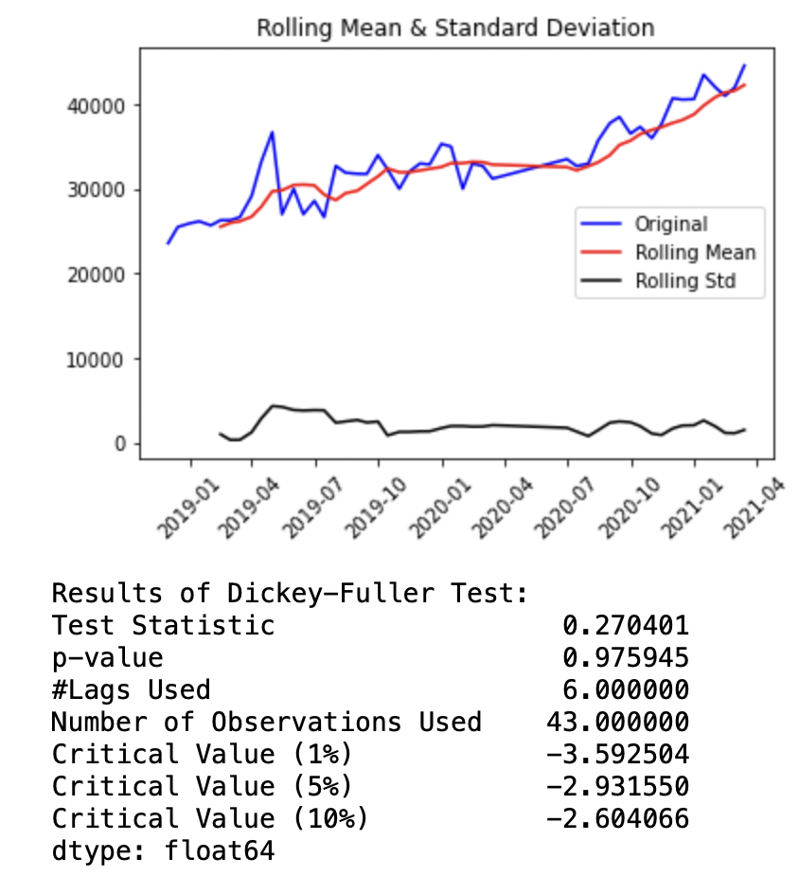
Stationarise the Series
p>0.05
Series is NOT stationary
Notes:
First we test stationarity of our unmodified series. We can somewhat see an upward trend and unsurprisingly, it is not stationary.

Slide 19
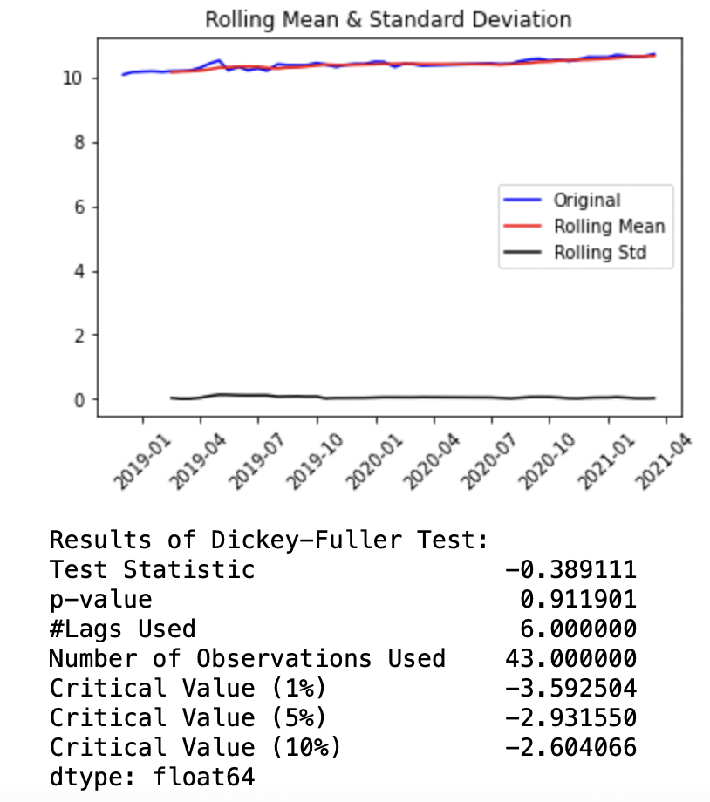
Stationarise the Series
p>0.05
Series is NOT stationary
Notes:
So we try using the log of the values and test for stationarity again. Expectedly, it is still non-stationary

Slide 20
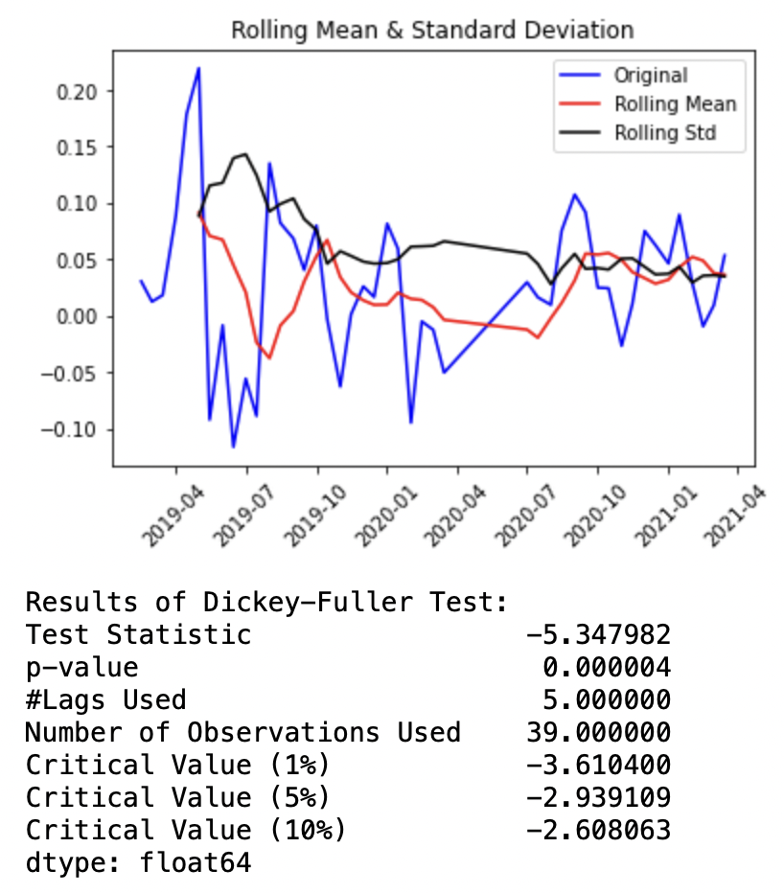
Stationarise the Series
p<0.05
Series is stationary
Notes:
Next, we did a first order differencing on the logged value and we finally have a stationary series with more than 95% onfidence.

Slide 21
Steps to Do!
Visualise the Data
Build the ARIMA Model
Make Predictions
Stationarize the Series
Find Optimal Parameters
Notes:
After knowing the differencing degree d, it is time to find the optimal p and q. (click)

Slide 22


Finding Optimal Parameters
Cross Validation
Grid Search
Notes:
To do that , we performed a grid search for values between 1 and 6 for p and q using a sliding window forecast cross validation

Slide 23
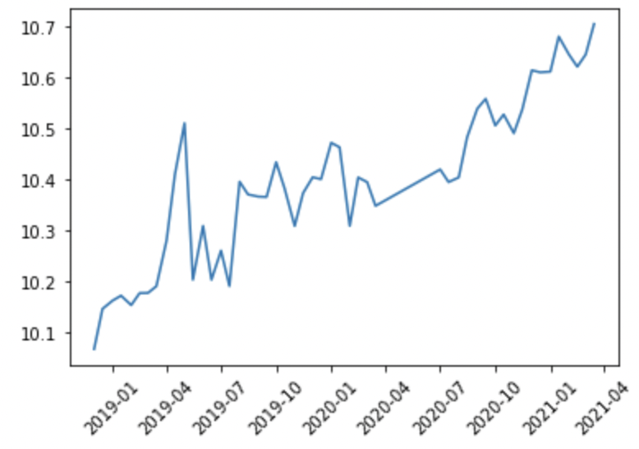
Sliding Window Cross Validation
Notes:
Sliding window forecast works by building the model on the window size, which is shown in yellow, testing it on the subsequent horizon, which is shown in purple,(click) . And the overall range shifts by a step size after every fold of cross validation. After some experimenting, we found out that window size of 24, step size of 2 and horizon of 2 to be appropriate parameters for the cross validation. Sum of squared errors is used as the loss function for the cross validation.

Slide 24

Grid Search
AR
MA
Notes:
After performing a grid search like this for all possible values in the grid, we got (5,1,2) as the optimal pdq for the ARIMA model.

Slide 25
Steps to Do!
Visualise the Data
Build the ARIMA Model
Make Predictions
Stationarize the Series
Find Optimal Parameters
Notes:
Next stop is building the model which is pretty simple.

Slide 26

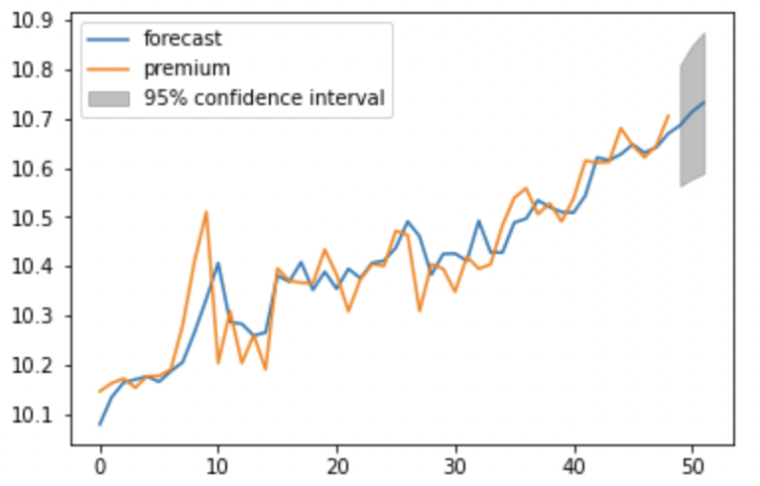
Building the Model
ARIMA
COE DATA
Notes:
So we just let ARIMA hammer our data with the given parameters, and we get our model.

Slide 27
Steps to Do!
Visualise the Data
Build the ARIMA Model
Make Predictions
Stationarize the Series
Find Optimal Parameters
Notes:
We then blew the model up back to the original scale

Slide 28
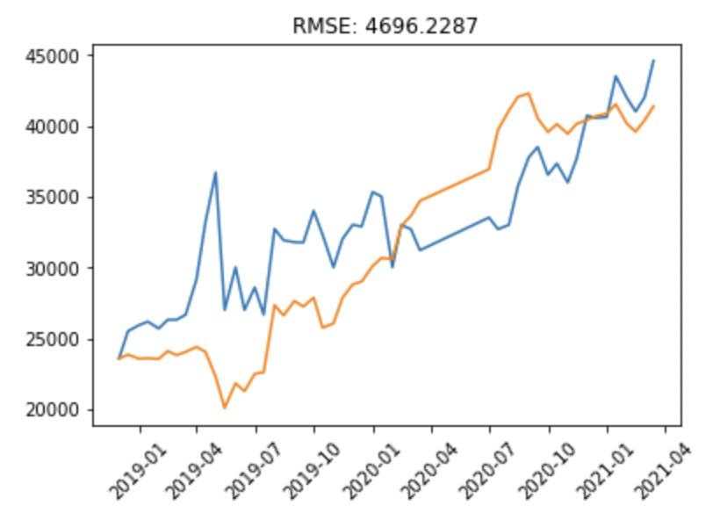
The Prediction
ARIMA
COE DATA
Notes:
and here is the plot of the actual premiums against our ARIMA model. As you can see, at the start it doesn’t look too good but that’s because ARIMA makes use of previous data to build a model but there is no previous data to begin with at the start. Moreover, I think the spike right here threw off the machine learning a bit. But it got better over time and at some point, we even got the actual values as the predicted values. The RMSE is also one of the lowest possible of all the models we tried.

Slide 29
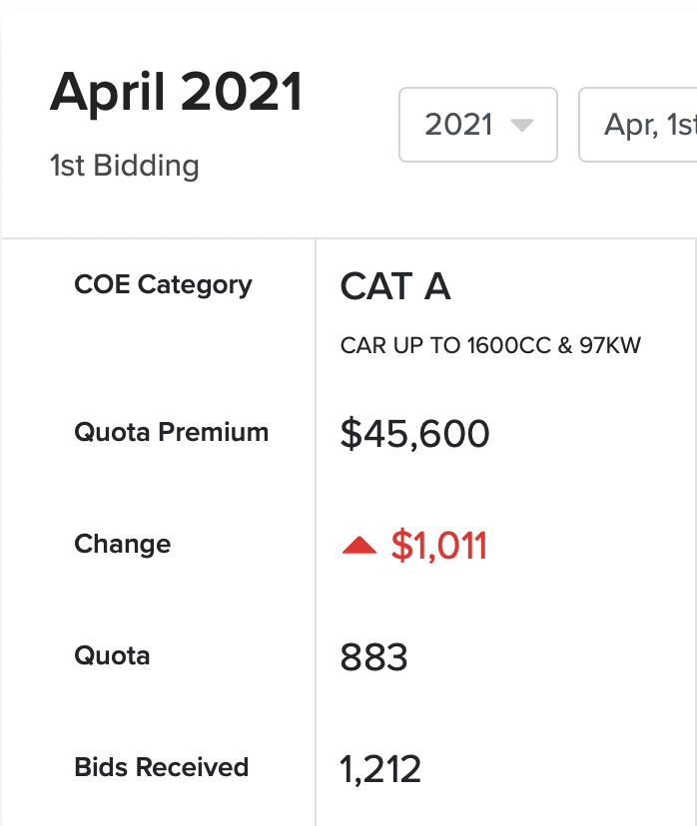
The VERDICT
ARIMA
Predicted | Actual
$43755 | $45,600
$44808 | ??????
COE DATA
Notes:
Using the ARIMA model, here are our predicted premiums for the month of April. And this is the result for the exercise on 7th of April. The second exercise will be conducted next week and you can see for yourself how close our prediction would be.

Slide 30

Work Distribution
ARIMA
Joel Tan
Goh Peng Aik
Khant Nyi Nyi
Business plan and data-driven insights
Exploratory Data Analysis and Data Cleaning
Machine Learning Techniques
COE DATA

Slide 31
Areas of Improvement
1. Facebook Prophet
2. Multivariate model with Quota and Revalidation Rate
3. Account for changing bid premiums with our predictions
Notes:
Before we end off, we have also identified certain areas that we can work on to further improve our project. We have considered trying out another time-series forecasting model called Facebook Prophet. Prophet is robust to shifts in the trend and typically handles outliers well. If we have the chance, we’ll try running our data through Facebook Prophet as well and see if it performs better than ARIMA.
We are also aware that the quota and revalidation rate are factors that would affect the premium prices of our COE and we think a multivariate model with those factors would bring greater accuracy to our predictions.
Lastly, with each users that follows our prediction, the bidding cut off price will fluctuate and if we can account for the changing bid premiums, it will bring greater accuracy to our predictions.

Slide 32
$81,734
$75,734
Notes:
So now with our ability to help you predict COE prices, you can go ahead and plan when to do a self-bid for a low COE premium to save some money on the already expensive car. Thank you for your time and attention!

Slide 33
References
https://cdn.motor1.com/images/mgl/EmBpM/s3/2020-toyota-corolla-sedan.jpg https://banner2.cleanpng.com/20190223/icg/kisspng-nw-innovation-resource-center-image-cartoon-animat-what-is-the-process-for-opening-a-trading-account-5c711ed1932850.2886581915509173296028.jpg
https://png.pngtree.com/png-vector/20190119/ourmid/pngtree-gesture-cartoon-cartoon-cartoon-man-png-image_476299.jpg
https://wiki.sg/p/Buying_a_car_in_Singapore
https://datamall.lta.gov.sg/content/datamall/en/static-data.html
https://icons8.com/icon/11355/grid
https://www.veryicon.com/icons/education-technology/big-data-risk-control-technology-intelligent/icon-big-data-cross-validation-1.html
https://www.unrankedsmurfs.com/blog/lol-season-9-start
https://tenor.com/search/bob-the-builder-gifs

